Slide 1

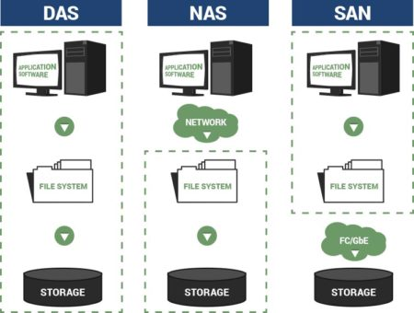
Storage in the Cloud
https://bit.ly/3RjE0PS

